Slide 1
Types of Elements &Form tags
DAY 5

Slide 2
TYPES OF ELEMENTS
INLINE ELEMENTS
BLOCK ELEMENTS

Slide 3
1.INLINE ELEMENTS
An inline element does not start on a new line.
An inline element only takes up as much width as necessary.
Eg:
<a>
<img>
<input>
<i>
<button>
These all display in line

Slide 4
2.BLOCK ELEMENTS
A block-level element always starts on a new line, and the browsers
automatically add some space (a margin) before and after the element.
A block-level element always takes up the full width available.
Eg:
<h1></h1>
<p></p>
<footer>
<form>
<main>

Slide 5
FORM
form is used to collect user input. The user input is most often sent to a server for processing.
<form> element is used to create an HTML form for user input.
Eg: <form>
<!--form elements-->
</form>

Slide 6
FORM ELEMENTS
<label>: It defines label for <form> elements or to display the text as label.
<input>: It is used to get input data from the form in various types such as text, password, email, etc by changing its type.
<button>: It defines a clickable button to control other elements or execute a functionality.
<select>: It is used to create a drop-down list.
<textarea>: It is used to get input long text content.
<option>: It is used to define options in a drop-down list.

Slide 7
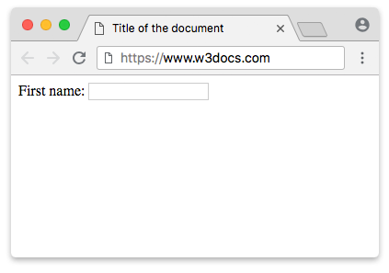
LABEL
The <label> tag defines a label for many form elements.
<lable for="">Username</label>
Set the identifier (id) inside the <input> element and specify its name as a for attribute for the <label> tag.
<label for="lfname">First name:</label>
<input id="lfname" name="fname" type="text" />

Slide 8
INPUT TAG
An <input> element can be displayed in many ways, depending on the type attribute.
<input type="text"> Displays a single-line text input field
<input type="radio"> Displays a radio button (for selecting one of many choices)
<input type="checkbox"> Displays a checkbox (for selecting zero or more of many choices)
<input type="submit"> Displays a submit button (for submitting the form)
<input type="button"> Displays a clickable button

Slide 9
SUBMIT BUTTON
-The <input type="submit"> defines a button for submitting the form data to a form-handler.
<input type="submit" value="Submit">
or
<button type="Submit"> Login</button>

Slide 10
REGISTRATION
<input type="button">
<input type="checkbox">
<input type="color">
<input type="date">
<input type="email">
<input type="file">
<input type="hidden">
<input type="image">
<input type="month">
<input type="number">
The default value of the type attribute is "text".
<input type="radio">
<input type="range">
<input type="reset">
<input type="search">
<input type="submit">
<input type="text">
<input type="time">
<input type="url">
<input type="week">
<input type="password">

Slide 11
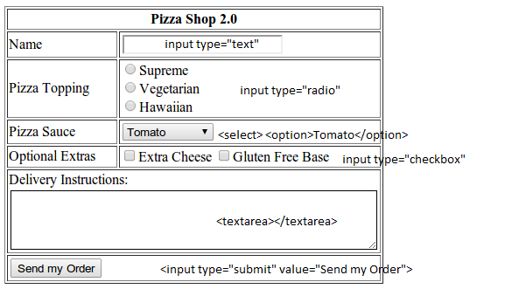
TASK

Slide 12
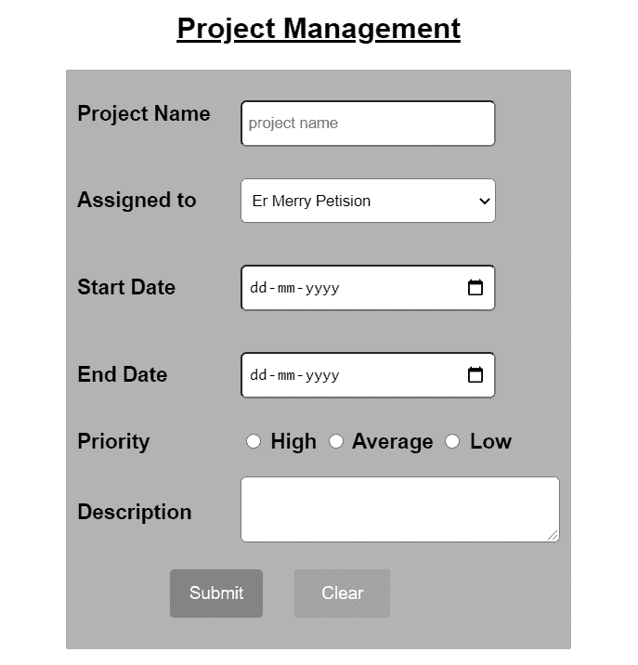
Task 2

Slide 13
